Slide 1


Android Lecture #
2week
Toast Message &
Dialog Box

Slide 2
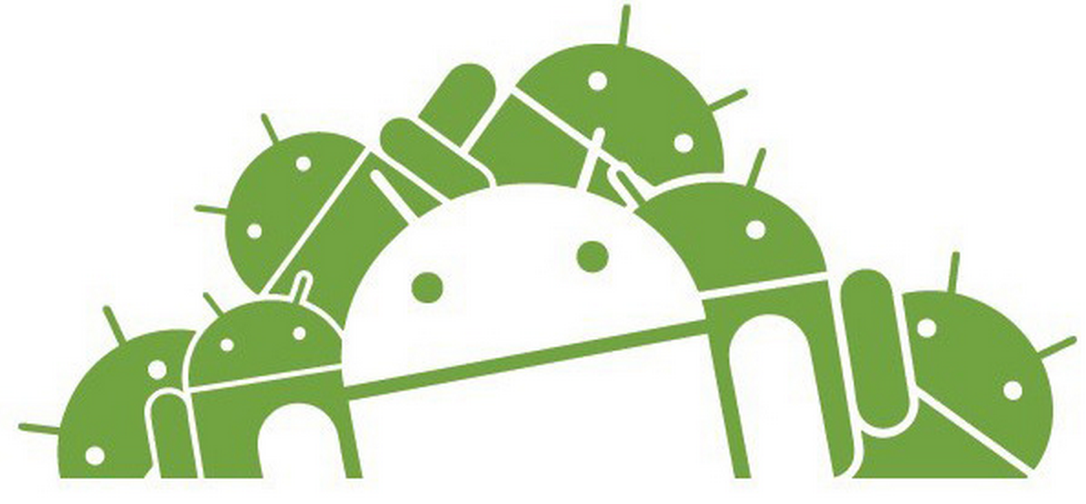
Contents
What is toast message?
Why & How to use it?
Example
What is Dialog Box?
Why & How to use it?
Example

Slide 3
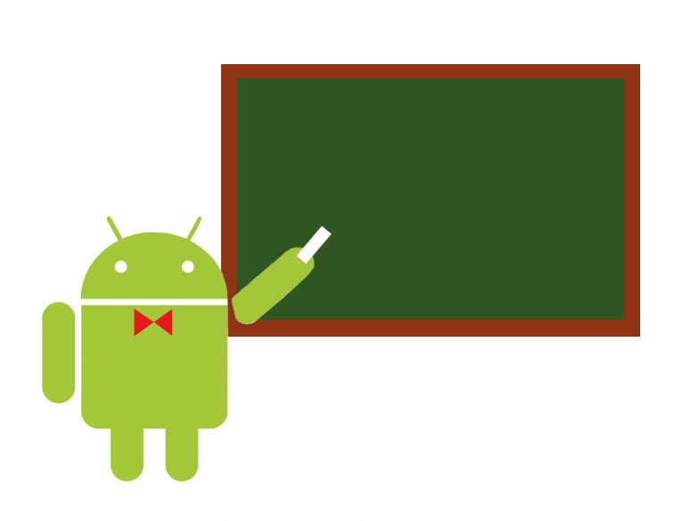
Toast Message

Slide 4

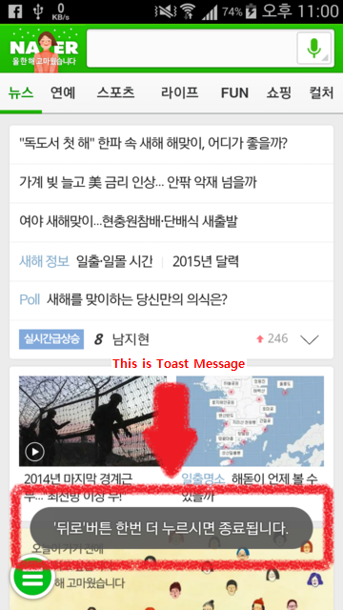
1. What is Toast Message?

Slide 5
2. Why we use it?
While Debugging ( Error detecting )
After application is appear, message is still alive

Slide 6

2. How to use it?
Toast.LENGTH_SHORT OR Toast.LENGTH_LONG

Slide 7
2. How to use it?
Toast.makeText(this,”Hello Android!”,Toast.LENTH_LONG);

Slide 8
2. How to use it?
gravity : Gravity.CENTER / select align
xOffset, yOffset : integer value / select the toast message box location

Slide 9
2. How to use it?

Slide 10
3. Example
SampleToast

Slide 11
Dialog Box

Slide 12
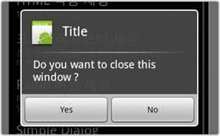
4. What is Dialog Box?

Slide 13
4. How to use it?
Toast is easy to debugging, dialog box is communication with user
Not taking input from user, just get answer like yes or no

Slide 14
5. Example
SampleDialog

Slide 15
Thank you!

